Slide 1
Control System Networks and Protocols
Capacity Building for Control System Security Collaborative Project

Slide 2
Greg Randall
Program Chair Computer Information Systems
Snead State Community College

Slide 3
Outline
Overview of Basic Networking and Protocols
OSI Model
TCP/IP Model
Industrial Control Systems
SCADA
SCADA Communications

Slide 4
Basic Networking Overview- Protocols
In the context of data communication, a network protocol is a formal set of rules, conventions and data structure that governs how computers and other network devices exchange information over a network.
In other words, protocol is a standard procedure and format that two data communication devices must understand, accept and use to be able to talk to each other.

Slide 5
What does a protocol cover?
A protocol is a set of rules that governs the communications between computers on a network.
These rules include guidelines that regulate :
Access method
Allowed physical topologies
Types of cabling
Speed of data transfer
Data flow
Error control

Slide 6
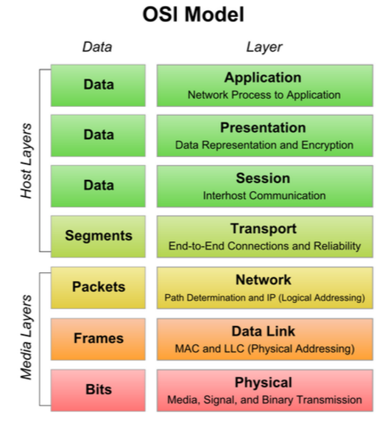
Open System Interconnect

Slide 7
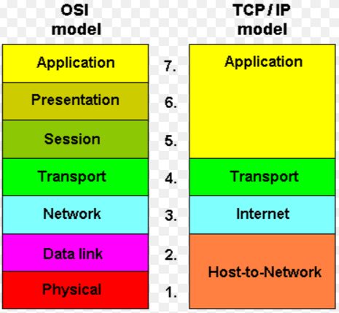
TCP/IP Model

Slide 8
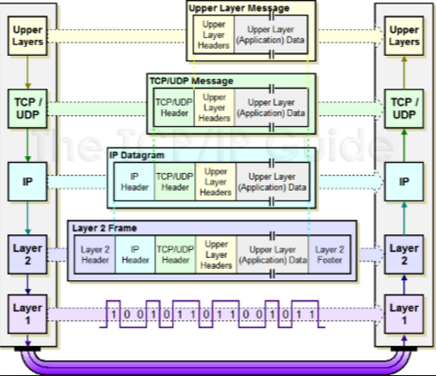
Control Systems Model

Slide 9
IP Addressing
IP Address- A unique 32 bit address that identifies each computer using the Internet Protocol to communicate over a network.
For human reading, we group the address into 8 bits separated by a decimal point, and converted to decimal. I.e. 209.65.109.12

Slide 10
IP Addressing Cont.
Public Address- An IP address that is routed publically on the Internet
Private Address- An address that is used for internal communication
Network Address Translation- NAT is an Internet standard that enables a local-area network (LAN) to use one set of IP addresses for internal traffic and a second set of addresses for external traffic.
A NAT box located where the LAN meets the Internet makes all necessary IP address translations.

Slide 11
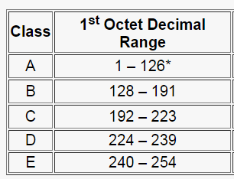
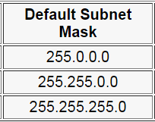
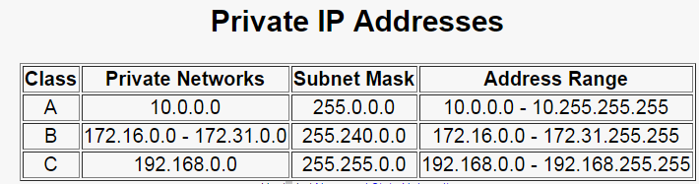
IP Addresses Classes

Slide 12
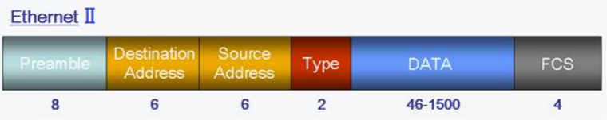
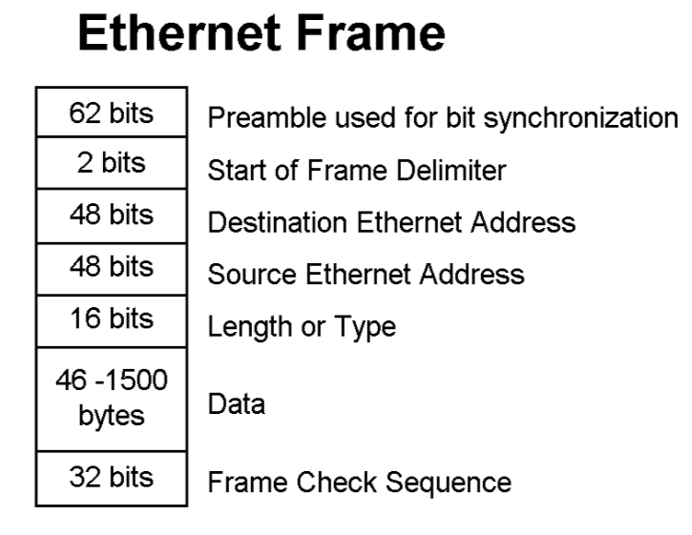
Layer 2- Data Link Frame
Payloads such as control system data

Slide 13
TCP/IP
TCP and IP were developed by a Department of Defense (DOD) research project to connect a number different networks designed by different vendors into a network of networks
IP - is responsible for moving packet of data from node to node. IP forwards each packet based the destination address (the IP address).
IP operates on gateway machines that move data from department to organization to region and then around the world.
TCP - is responsible for verifying the correct delivery of data from client to server. Data can be lost in the intermediate network.
TCP adds support to detect errors or lost data and to trigger retransmission until the data is correctly and completely received.

Slide 14
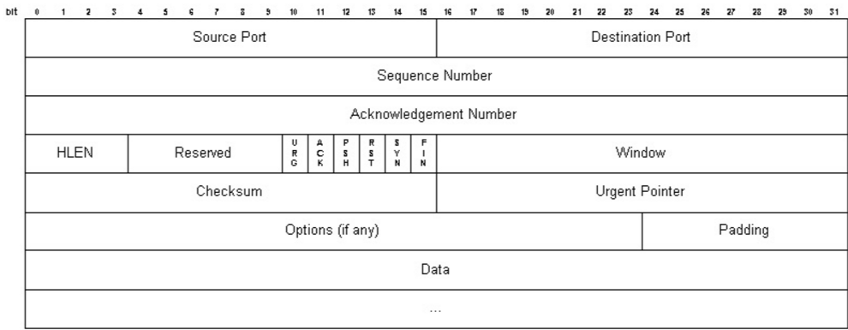
TCP Frame Format

Slide 15
Protocol Ports
A port is an endpoint of communication in an operating system.
A port is always associated with an IP address of a host and the protocol type of the communication, and thus completes the destination or origination address of a communications session.
A port is identified for each address and protocol by a 16-bit number, commonly known as the port number. The range is from 0-65535
Specific port numbers are often used to identify specific services.
Type of ports
Ports 0-1023- well-known port numbers. I.e. HTTP= port 80, FTP= port 20 and21
Ports 1024-49151 - registered ports: use for vendor applications
Ports >49151 - dynamic / private ports

Slide 16
Industrial Control System (ICS)
Industrial control system (ICS) is a general term that encompasses several types of control systems used in industrial production, including:
Supervisory Control and Data Acquisition (SCADA) systems
Distributed Control Systems (DCS)
Programmable Logic Controllers (PLC); often found in the industrial sectors and critical infrastructures

Slide 17
ICS
ICSs are typically used in industries such as electrical, water, oil, gas and data.
Automated or operator-driven supervisory commands can be pushed to remote station control devices, which are often referred to as field devices.
Field devices control local operations such as opening and closing valves and breakers, collecting data from sensor systems, and monitoring the local environment for alarm conditions.

Slide 18
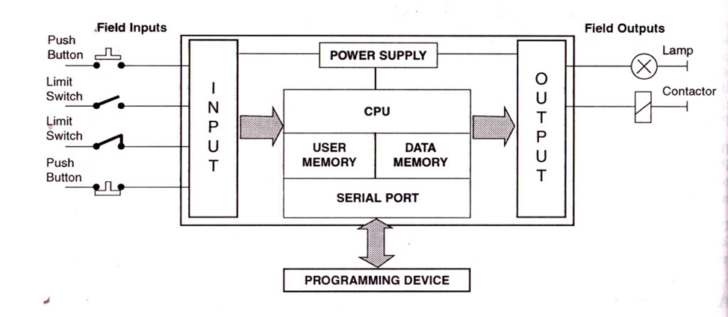
Basic PLC Device

Slide 19
Supervisory Control and Data Acquisition (SCADA)
SCADA generally refers to an industrial computer system that monitors and controls a process.
In the case of the transmission and distribution elements of electrical utilities, SCADA will monitor substations, transformers and other electrical assets.

Slide 20
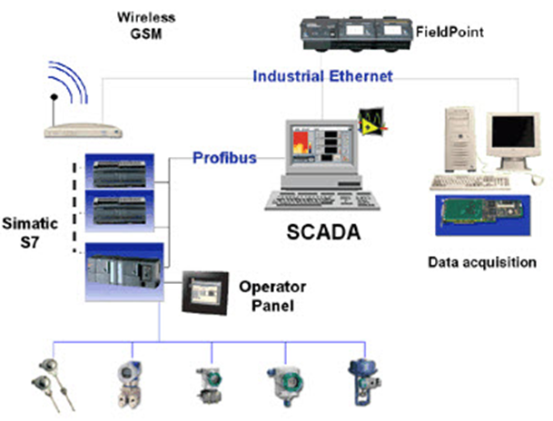
General SCADA Diagram

Slide 21
Remote Terminal Unit (RTU)
A Remote Terminal Unit is an electronic device that is controlled by a microprocessor.
The device interfaces with physical objects to a Distributed Control System (DCS) or Supervisory Control and Data Acquisition (SCADA) system by transmitting telemetry data to the system.

Slide 22
Distributed Control System (DCS)
A distributed control system (DCS) is a control system for a process or plant, wherein control elements are distributed throughout the system.

Slide 23
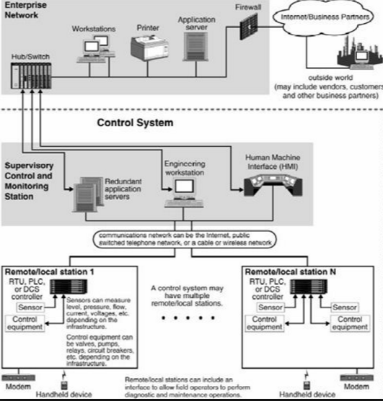
DCS

Slide 24
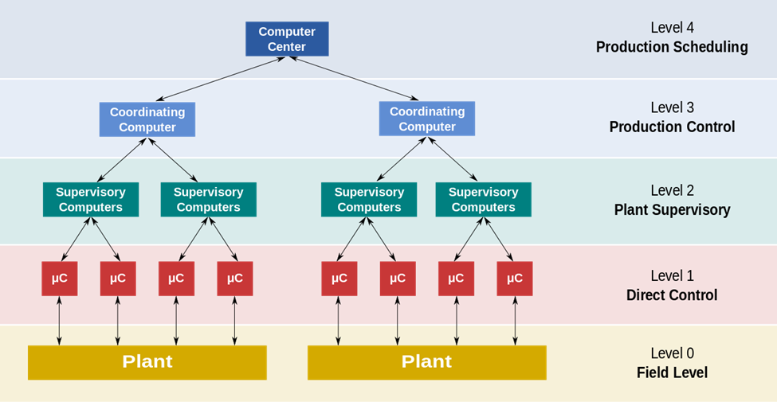
DCS Continued

Slide 25
Human Machine Interface
An HMI is a software application that presents information to an operator or user about the state of a process, and to accept and implement the operators control instructions.
Typically information is displayed in a graphic format (Graphical User Interface or GUI).

Slide 26
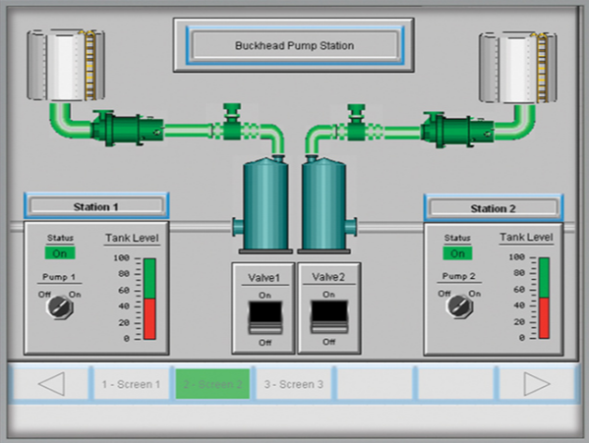
HMI

Slide 27
Communication Protocols
Communication Protocols are the rules used to send and receive data from the SCADA, DCS, and HMI
This communication is facilitated through the use of:
Computer Systems
RTUs
TCP/IP Stack
Interaction with other protocol layers

Slide 28
Industry Communication Protocols

Slide 29
Distributed Network Protocol (DNP3)
DNP3 (Distributed Network Protocol) is a set of communications protocols used between components in process automation systems.
Its main use is in utilities such as electric and water companies. Usage in other industries is not common.
It was developed for communications between various types of data acquisition and control equipment.
It plays a crucial role in SCADA systems
Used where RTUs, and Intelligent Electronic Devices (IEDs) reside.
It is primarily used for communications between a master station and RTUs or IEDs.
DNP3 maintains connection with telephone wire, fiber, Ethernet cable, and radio.

Slide 30
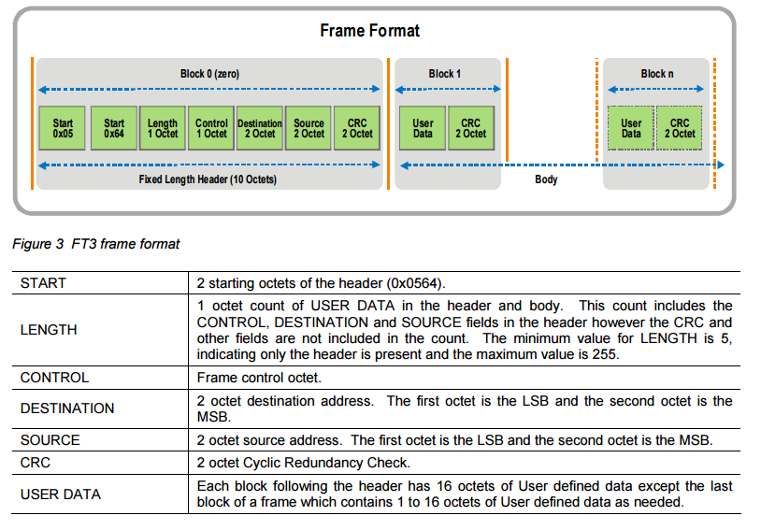
DNP3 Cont..
DNP3 typically uses the TCP/IP protocol stack for communication

Slide 31
Open Platform Communications (OPC) Unified Architecture
OPC UA is a series of standards and specifications for secure and reliable industrial telecommunication.
An industrial automation industry task force developed the original standard in 1996 under the name OLE for Process Control (Object Linking and Embedding for Process Control).
OPC specifies the communication of real-time plant data between control devices from different manufacturers. Hence, Unified Architecture
Specifically used in windows-based platforms and HMI but now is used in Java and Linux
Best used in a Web-based control system.

Slide 32
Profibus
PROFIBUS (Process Field Bus) is a standard for fieldbus communication in automation technology first used by Siemens.
Profibus uses a standard twisted-pair wiring system (RS485) or fiber optic cable.

Slide 33
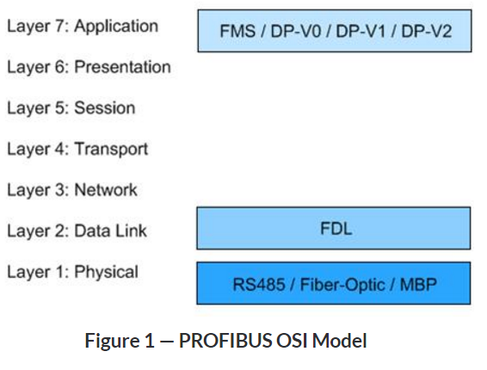
Profibus Cont..
FMS- Fieldbus Message Specification for PLC communication.
DP- Decentralized Periphery, this new protocol is much simpler and faster.
FDL-Field bus Data Link
MBP- Manchester-Coded Power Bus- permits transmission of both data and power

Slide 34
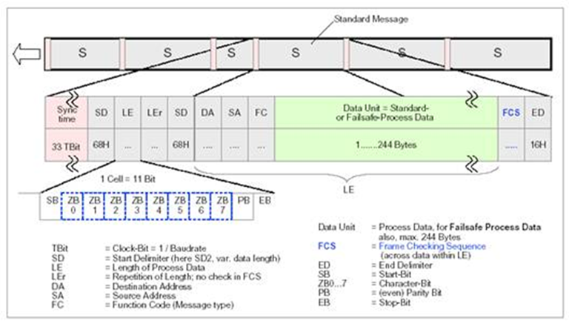
Profibus Frame Structure

Slide 35
EtherNet/Industrial Protocol
Combines standard Ethernet with Common Industrial Protocol (CIP)
The Common Industrial Protocol (CIP) is an industrial protocol for industrial automation applications
Widely used in a range of industries
CIP is capable of operations that provide three required services:
Control of Industrial Devices
Configuration of Devices
Collection of Real-Time Data

Slide 36
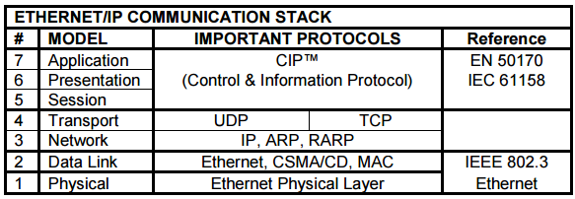
EtherNet/IP Communication Stack
CIP provides for utilization of the top three layers of the OSI Model
Standard Ethernet practices on the network of choice utilize the last three layers of the OSI Model

Slide 37
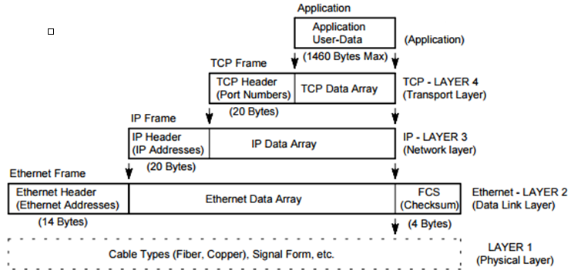
EtherNet/IP Frame Structure

Slide 38
Modbus
Original protocol used to communicate between Modicon devices.
Modbus is a popular communication protocol in various industrial control settings.
Modular Digital Controller was the name given to the first commercial Programmable Logic Controller built in 1969
Two basic versions of Modbus include:
Modbus RTU- Open serial communication (RS-232 or RS-485)
Modbus/TCP- Ethernet attachment to control devices
In Modbus/TCP, RTU messages are transmitted in a TCP/IP packet and sent over a network instead of serial lines.

Slide 39
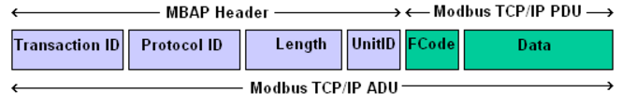
Modbus Frame Format
MBAP- Modbus Application Header

Slide 40
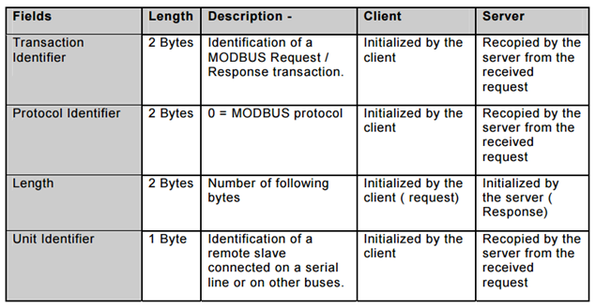
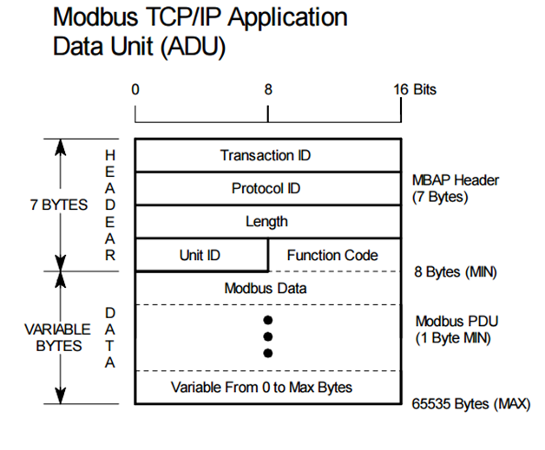
Modbus Packet Fields

Slide 41
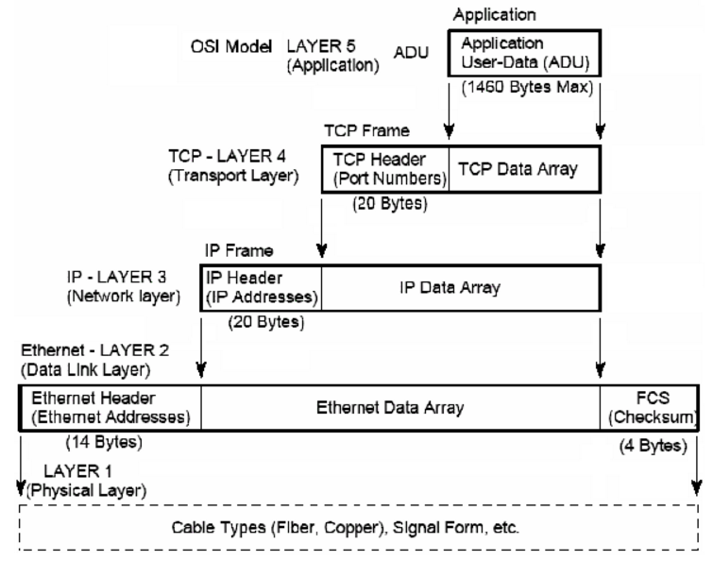
Modbus/TCP- Data Packet

Slide 42
Questions??

